Slide 1

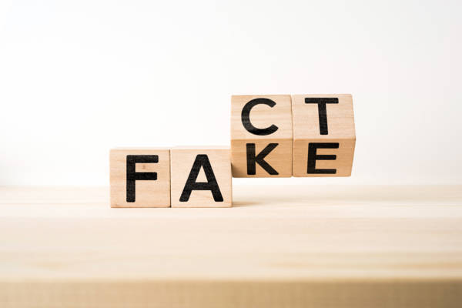

FAKE NEWS DETECTION
Using machine learning
Thesis Defense
Name: DISHA JAIN
Section: ML
University roll no : 2021878
Presented by Juliana Silva
Mentor by: Dr. Neha Tripathi

Slide 2

INTRODUCTION
This outgrowing technical industry is overpowering the brains of many people out there. Everyone is becoming more and more accustomed to the need and usage of technology. There are many cyber criminals who use this technical for various corruptions . One of those is spreading fake news among their readers. It is a serious concern to look into it as once the news is out people start believing it without its verifications which can also lead to spreading of hatred, misconceptions and a lot more.
So, Machine learning comes as a saviour to this problem of fake news. Machine learning is the subcategory of artificial intelligence which focuses on training the model according to the various algorithms and thus testing it to produce the result.

Slide 3
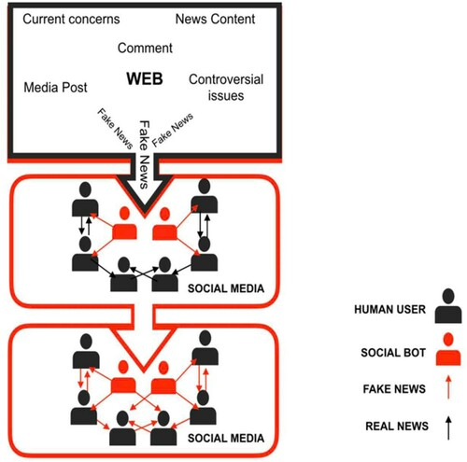
Problem Statement:
We are provided with a large dataset consisting of over 1000 statements of news articles headlines. Some of them are fake and some of them are true ones. We are required to build a model that is capable of detecting if the statement in the article is fake or true . For this we are using various machine learning algorithms to train the model so we can predict the result. Fake news is a big concern which is no longer hidden from this world. And people are becoming more and more aware of this problem. So, the responsibility increases to build the most precise model for detecting fake news.

Slide 4
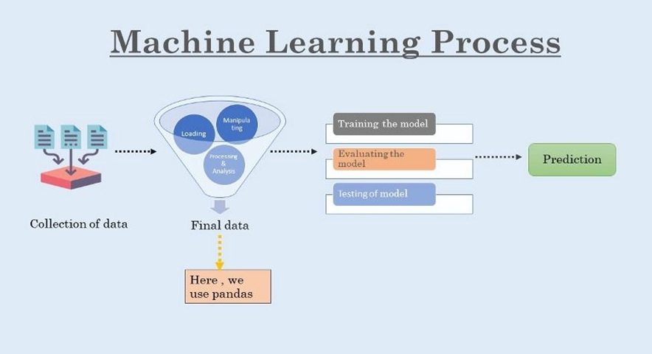
Methodology
A systematic process is being followed to build a model which we will be discussing in this section. The first step in this is the dataset collection phase, followed by preprocessing, then implementing selection features and then training and testing the dataset and then finally running the model to predict news and declare it to be true or false. We have taken the use of machine learning to build our model.

Slide 5
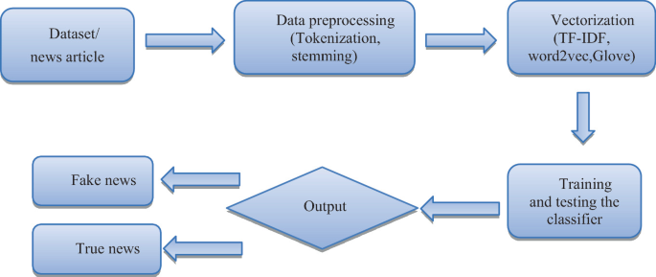
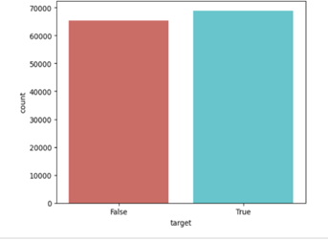
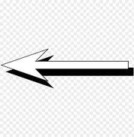
This image shows how the Dataset is firstly preprocessed, Then vectorization is applied on it to make machine to interpret the data in binary values. Here the process of data pre-processing concludes..
This is the output of our dataset which we are using to build this model. This image shows that our dataset contain how much amount of fake and true news articles which will be further trained and and tested accordingly.

Slide 6
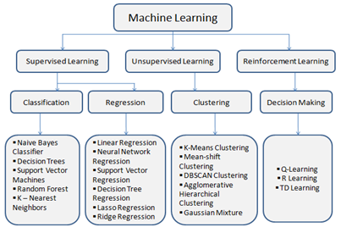
After the data pre- processing , data is trained on basis of supervised machine learning algorithm in which classification algorithms are mostly preferred over regression ones as they are more precise in this case. After this training process, Testing is being conducted for the accuracy and then fake news test is done.

Slide 7
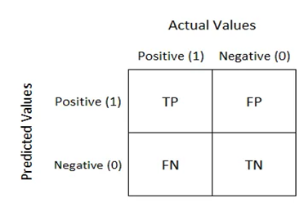
RESULT
After applying various supervised machine learning algorithms and also by taking the help of confusion matrices , we concluded that which algorithm we have to use to train our model , so that it will give us the most precise result.
Confusion matrix is a table of two rows and two columns consisting true positive, false positive, false negative and true negative.
It is called so as it is used in predictive analysis, i.e., it is used to predict whether the machine is confused between the two.

Slide 8
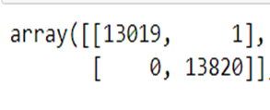
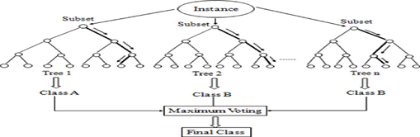
This is the confusion matrix of random forest algorithm which shows that random forest supervised machine learning algorithm gives 0 false negative statement , i.e., this algorithm do its best to predict the result.
Random forest is a known supervised machine learning algorithm that is used to solve the cases related to regression and classification as well. In this case it is used as a classification algorithm in which it has to differentiate whether the news is true or false.
Thus, this classification supervised machine learning algorithms proved that they can solve this issue of fake news and make such models to predict them.

Slide 9
Conclusion
Spreading news or we can say making people aware of what is happening around the world, this all work takes a few minutes to be uploaded on the internet. So, it is very important to verify whether the news that is being spreaded is correct or if it is someone’s purpose to destroy someone. For this supervised machine learning proved to be of great help to make a model which can predict.We have seen that random forest proved to be the one algorithm which helped in building a model which we needed.
In this field, a lot more is left to be analysed and be looked into. Regularly emerging technologies and methods can be searched for. Searching into unsupervised machine learning algorithms and considering them can be a point that can be taken in the future. Using those methods which will help in the sustainable development of the society will be considered.

Slide 10


